Slide 1

Smart Fault Monitoring Device
CS 684 - Embedded Systems
Spring 2018
Guide
Prof. Kavi Arya
Mr. Naveen Cherupally
Group Members
Abhishek Pal -173074015
Anil Kumar Garg -173074018

Slide 2
Problem Statement
Objective
A Smart Fault Monitoring Device can be used for monitoring the trip/fault status across MCB in domestic and industrial safety application.
This will log trip information and intimate to user using IoT device
Product Impact
All residential and commercial establishments.
Be a part of Smart City initiative.

Slide 3


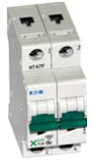
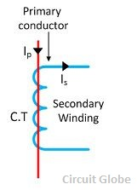


Scheme
Smart Fault Monitoring Device
Interface Circuit
Luanchpad uC + Adc
ESP8266

Slide 4
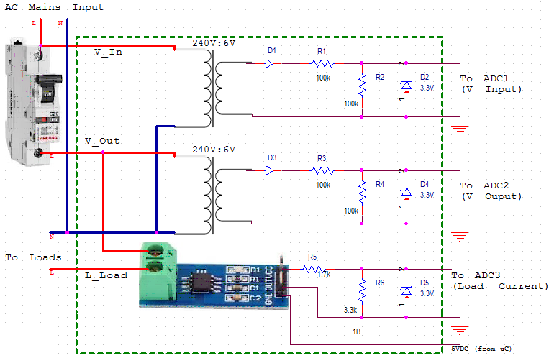
Signal Conditioning

Slide 5
Power Status Monitoring
Power OK : Voltages on Primary & Secondary side of MCB are OK.
No Power: Mains supply is not coming.
MCB Tripped: MCB got tripped due to overcurrent, short circuit etc.

Slide 6
Requirements
Hardware
ESP8266/GSM
Tiva Launchpad
AC Voltage & Current Sensor
5VDC Supply
Software
CCS 6.1.2
MOS (for IoT Device)
AWS Platform
Serial Console

Slide 7
Challenges
Challenges
Safety precaution to be followed, while working with live high voltages.
Hardware selection for Wireless communication.
Sensor selection for AC current and voltage.
Sensor calibration
Real time DC offset calibration.
Exploring web/email/Android interface for user notification
Acquiring the skills for the IoT device programming.

Slide 8
Deliverables
Smart Fault Monitoring Unit
Microcontroller board with ADC/sensors
IOT device
Front-end GUI (Android / web interface)

Slide 9
Test Strategies
Measurement Tests : To verify measured input current and voltage values
Fault Monitoring and Test : To verify the detection of MCB trip contact status
Communication Test: Send the fault/trip alert to the user via internet/AWS
Front-end testing

Slide 10
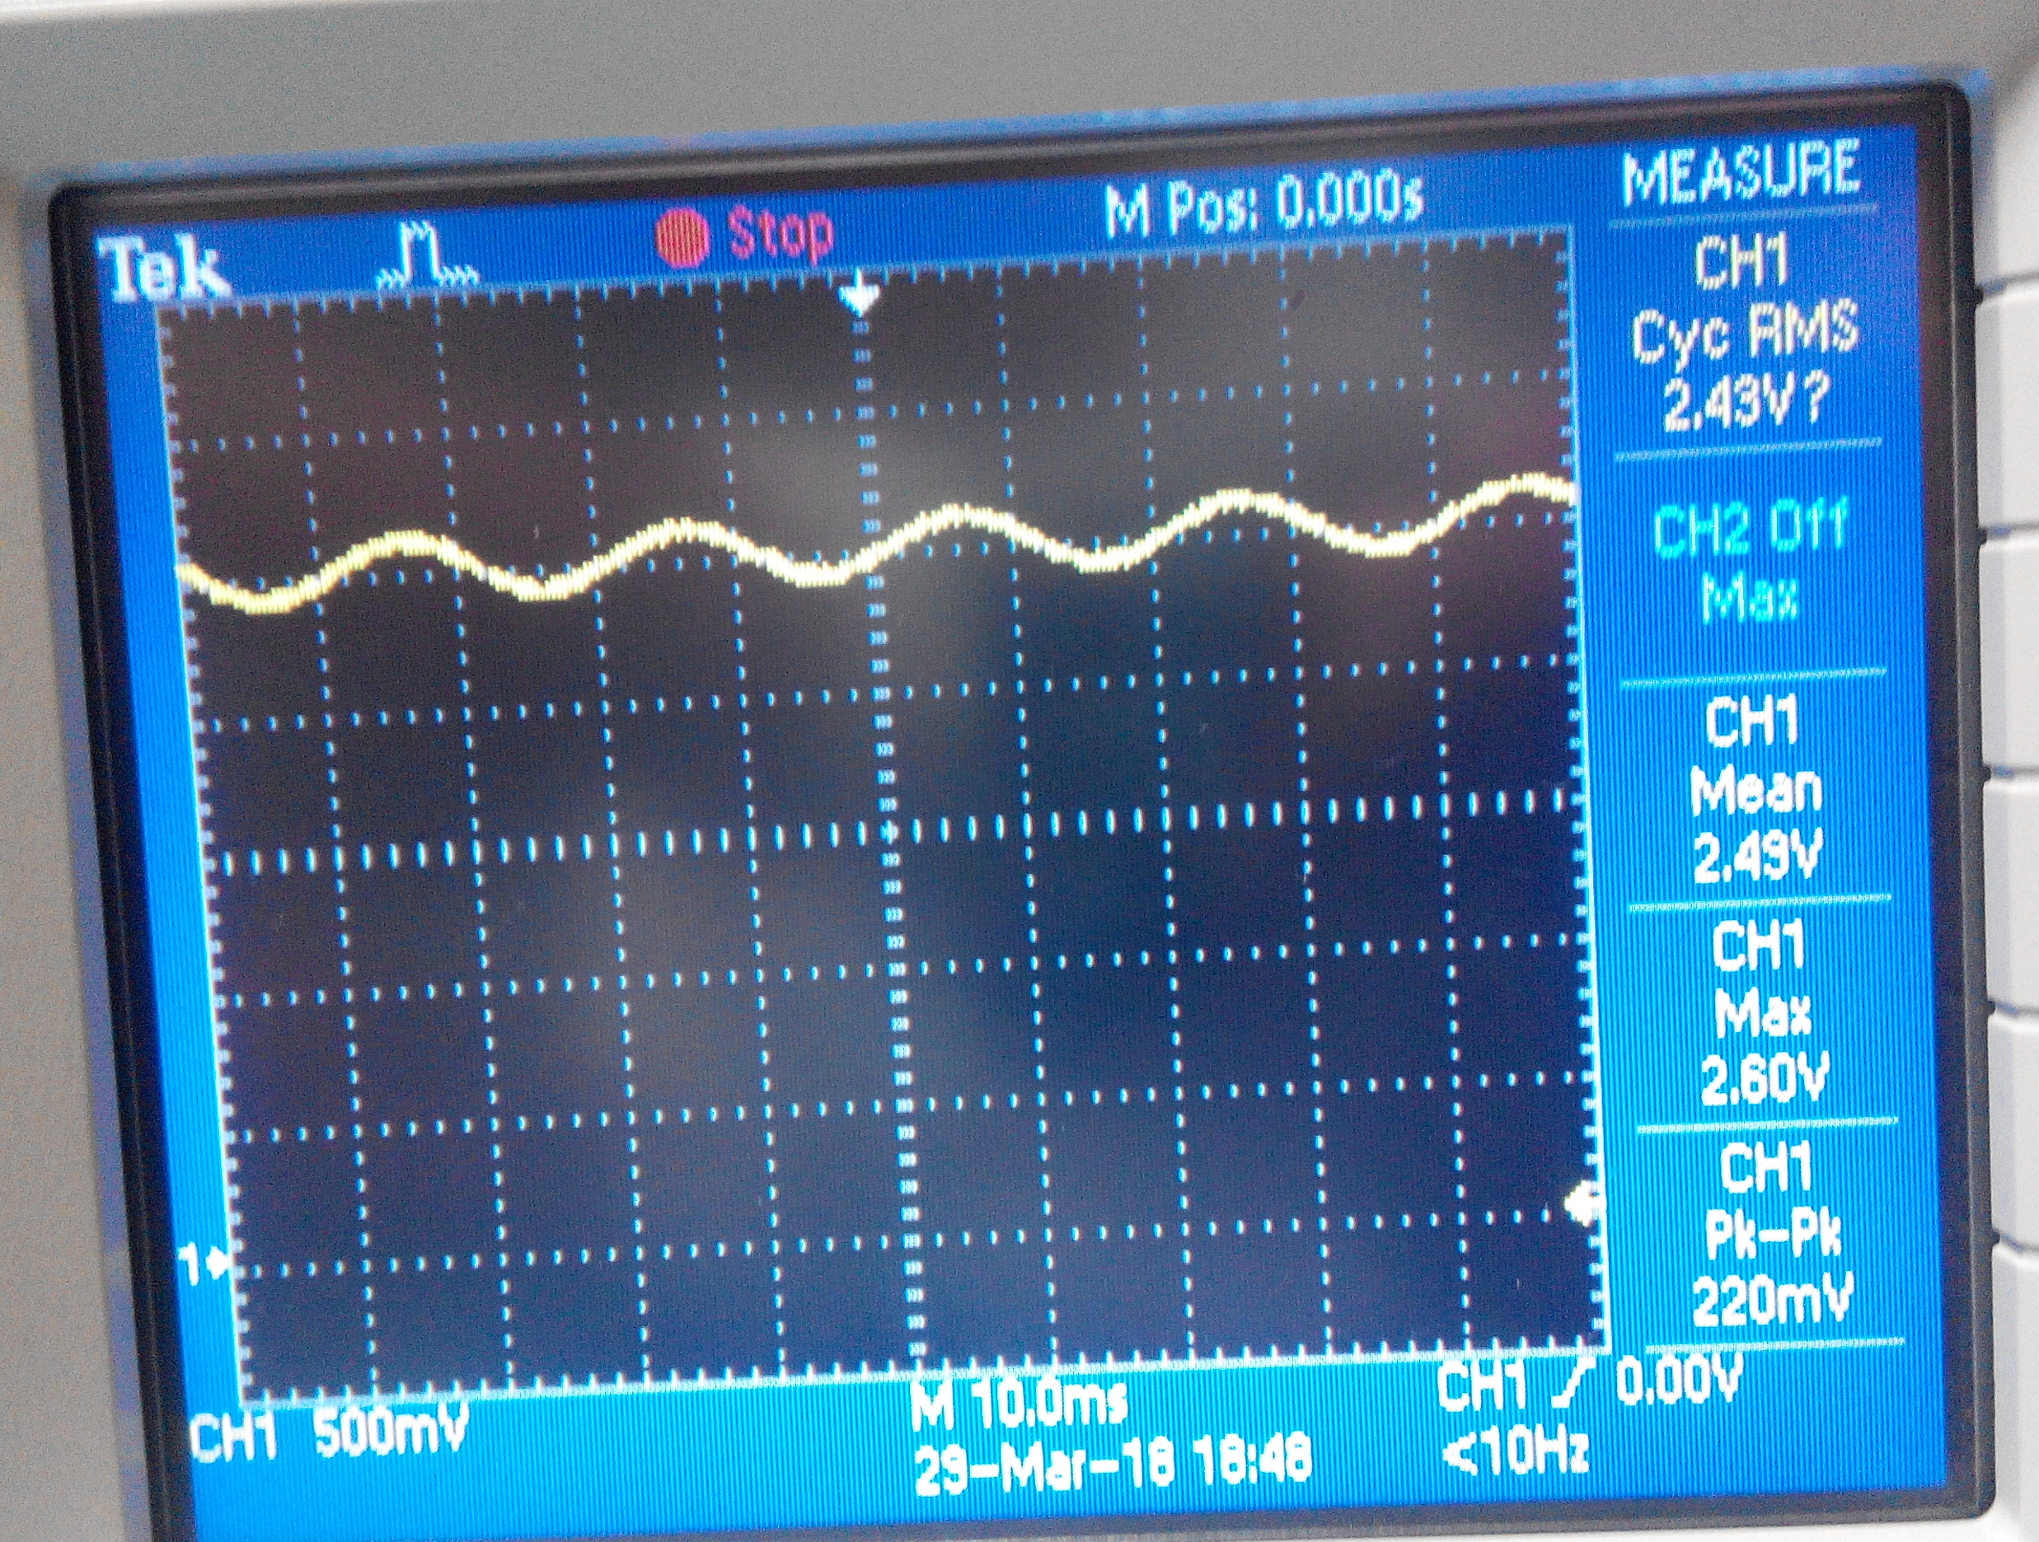
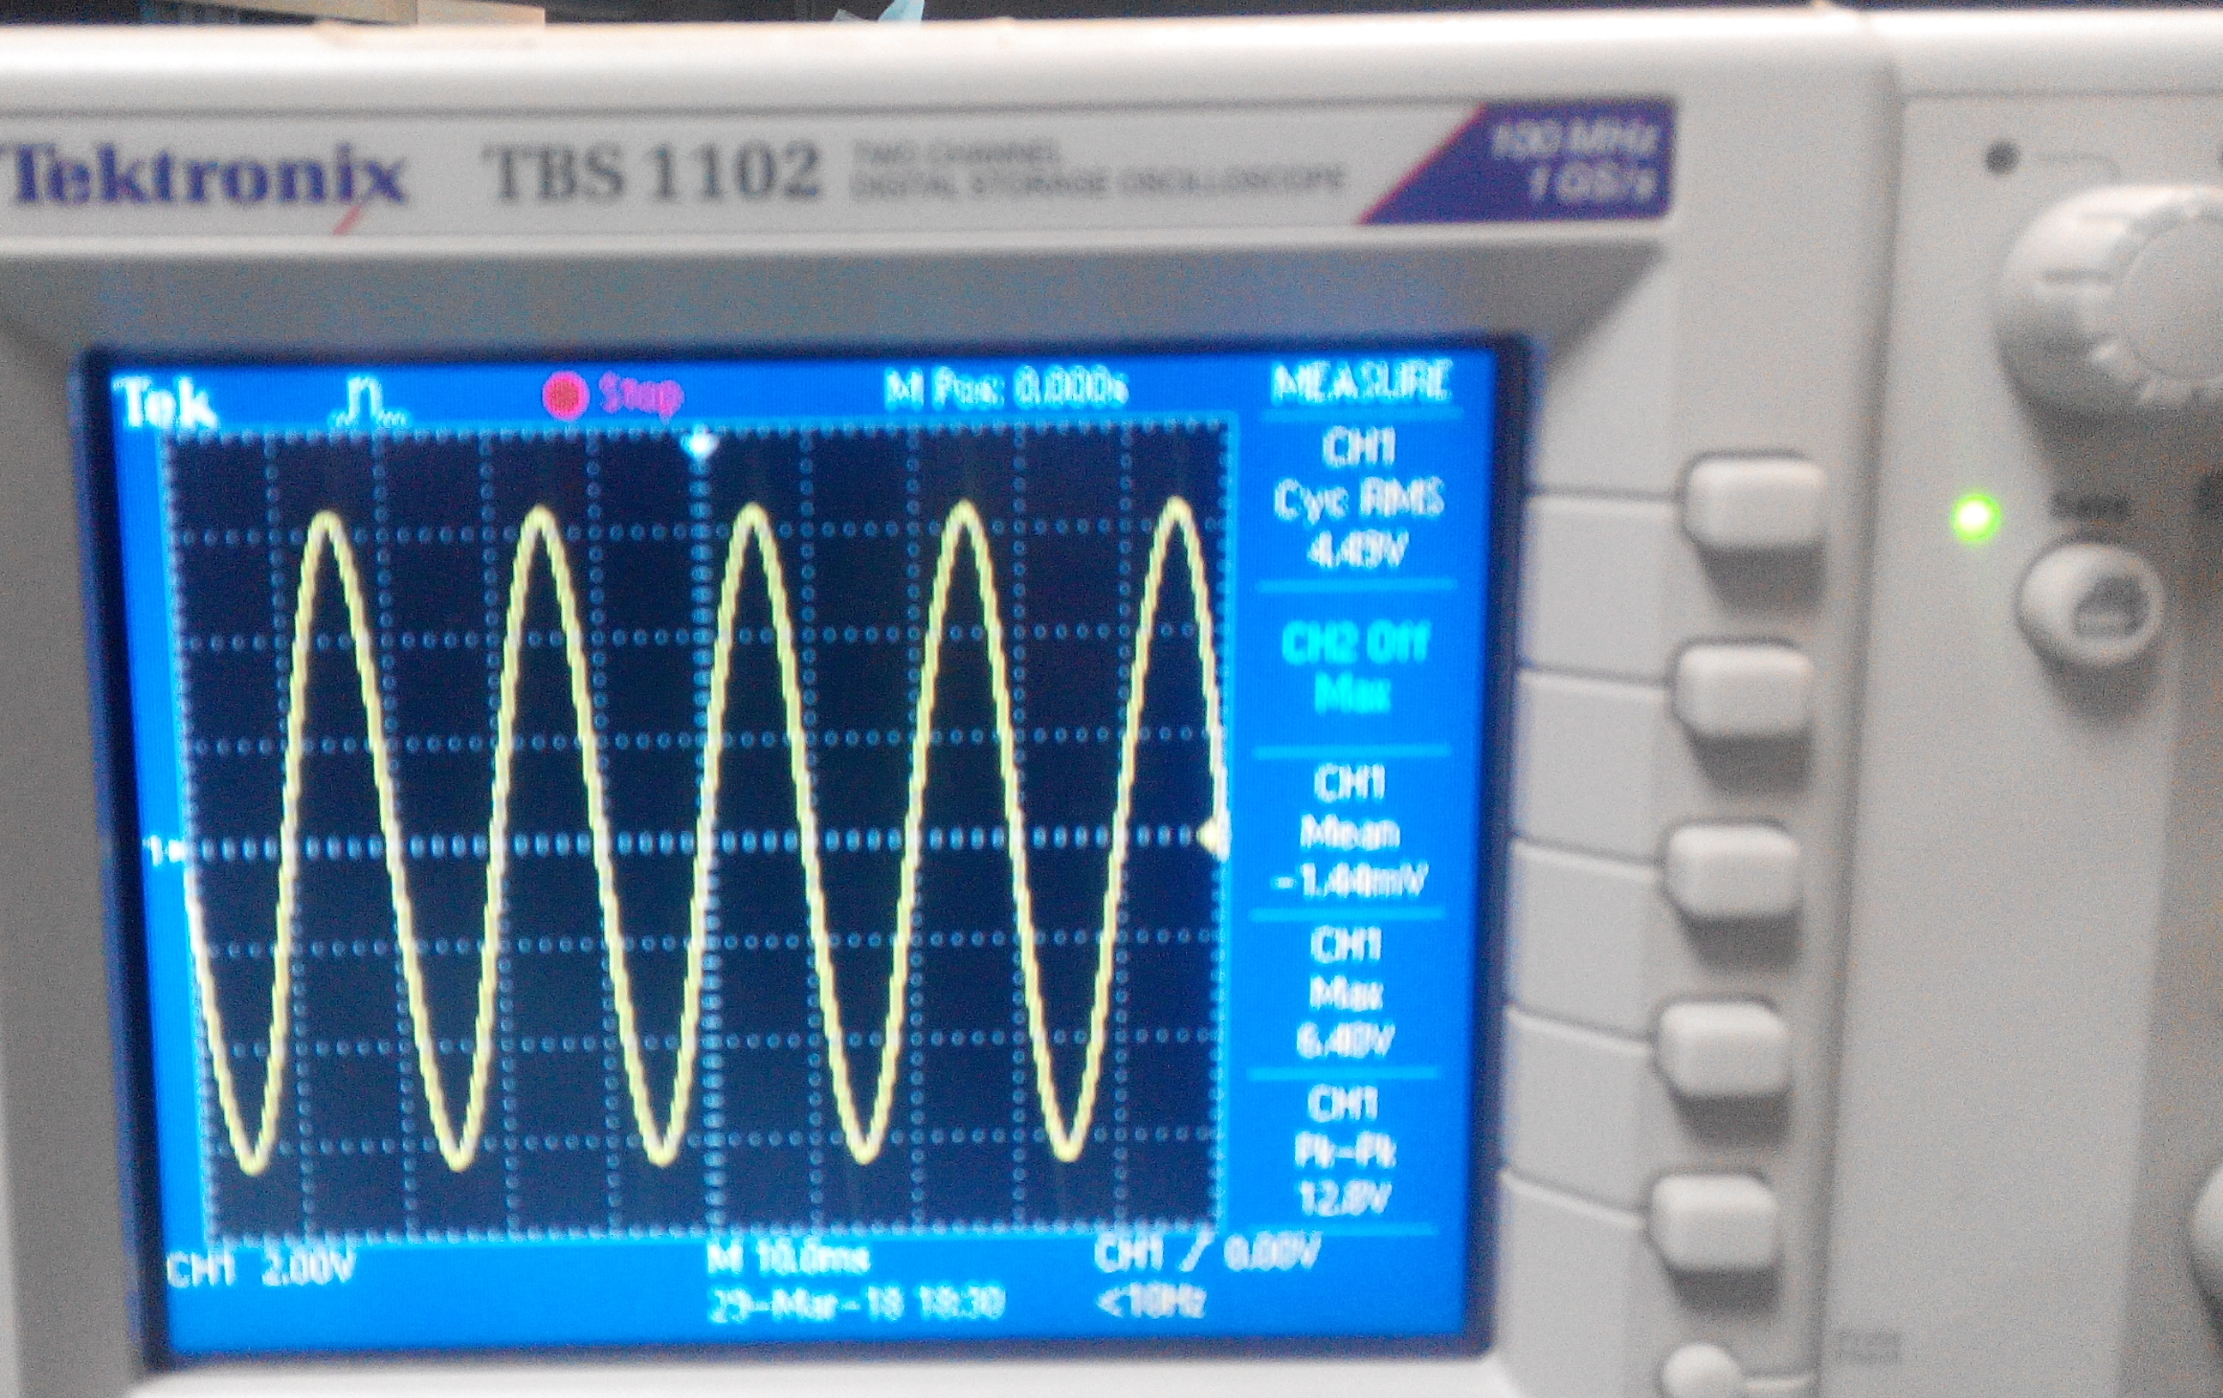
Test Results ..1
ACS712 - 30A Current Sensor
Voltage Sensor
Ip (Input), Amp (rms) | Sensor O/P Volt (Vpp)
0.25 | 56.8mV
0.5 | 101mV
1 | 220 mV
2 | 420 mV
3 | 620 mV
4 | 820 mV
5 | 980 mV
6 | 1.18 V
7 | 1.38 V
8 | 1.58 V
9 | 1.76 V
10 | 1.94 V
Primary Volt | Secondary Volt
240 V | 6.04 V

Slide 11
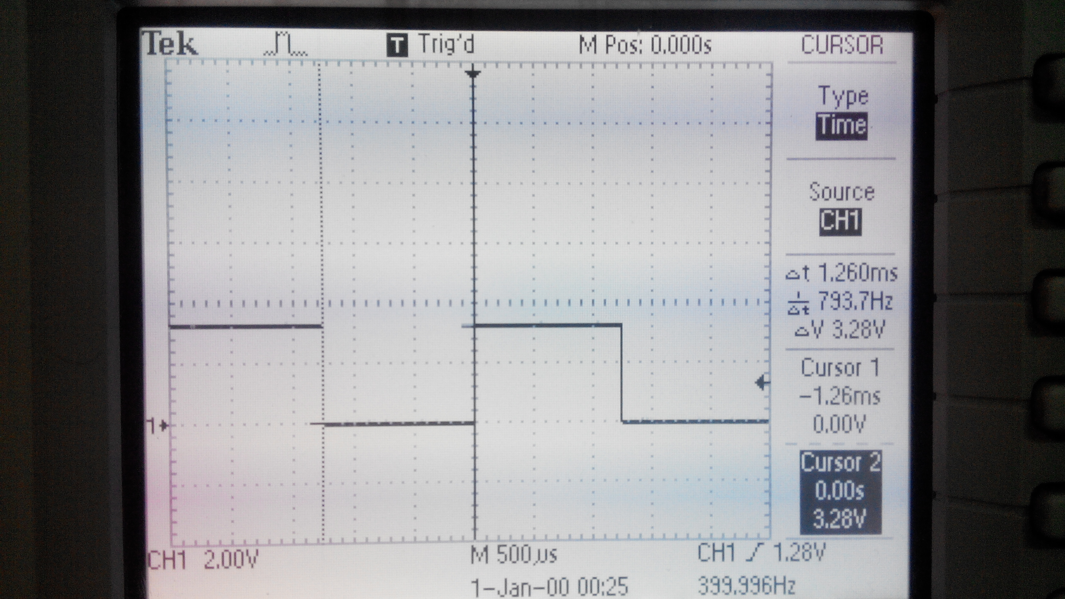
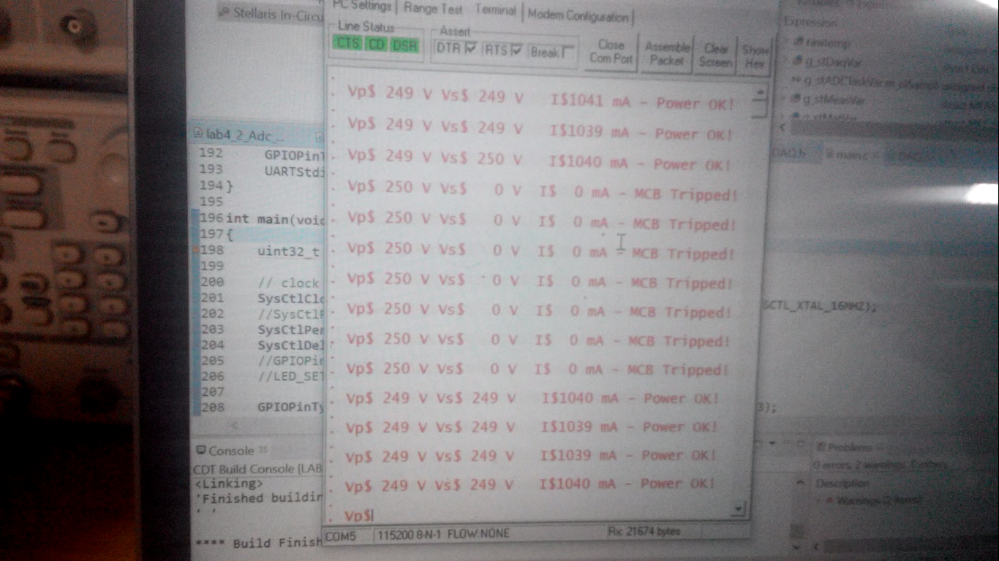
Test Results ..2
Tiva
ESP
Timer Interrupt Generation & Verification | Done
ADC SoC Generation & Data read Verify | Done
Volt/Current RMS calculation logic | Done
Fault status decoding logic | Done
Fault intimation on UART | Done
ESP8266
Arduino IDE & library installation | Done
ESP programming procedure | Done
ESP UART communication with Tiva
ESP Wifi Comm.
ESP Notification Sending
SMS/Web/Email/Android Notification
IoT Platform (AWS/Android) Interface

Slide 12
Timeline
Activity | Timeline (EDC)
Project Discussion & Finalisation | 2nd Week – March’18
Component & Sensor Selection | 3rd Week – March’18
Component & Sensor Ordering & Receipt | 3rd- 4th Week – March’18
Component/Sensor Testing | 4-5th Week – March’18
Coding & testing – Microcontroller (measurement & processing) | 4-5th Week – March’18
Communication with microcontroller & IoT device | 1st Week – April’18
Front-end development & communication with IoT | 2nd Week – April’18
Integrated Testing | 3rd Week – April’18
Final Presentation | 16th April, 2018

Slide 13
Thank You

